Slide 1


Pfizer and ZoomRx –
PENBRAYA ATU Pilot
January 2026

Slide 2

ZoomRx and Pfizer PENBRAYA ATU Pilot
1. INTRO TO ZOOMRX & ATU PLATFORM
2. PFIZER/ZOOMRX PENBRAYA ATU PILOT

Slide 3




ZoomRx is a global life sciences insights firm, providing end-to-end services to help our clients make better decisions
Thought Leadership and Innovation
Thought leadership built on top of our own innovative survey platform. We are leaders in integrating the latest AI advances into the survey-taking experience, transforming how insights are captured, analyzed, and applied.
15
years of life-sciences consulting
10 of 10
Deep HCP & Patient Panel
Proprietary in-house 56K+ HCP and patient network that enables rapid, targeted insights from relevant audiences.
largest global pharma companies partnered
Therapeutic Area Expertise
An experienced team who knows your market well, helping you make better decisions. We have been partnering with Pfizer vaccines since 2023.
450+
life sciences consultants across the globe

Slide 4




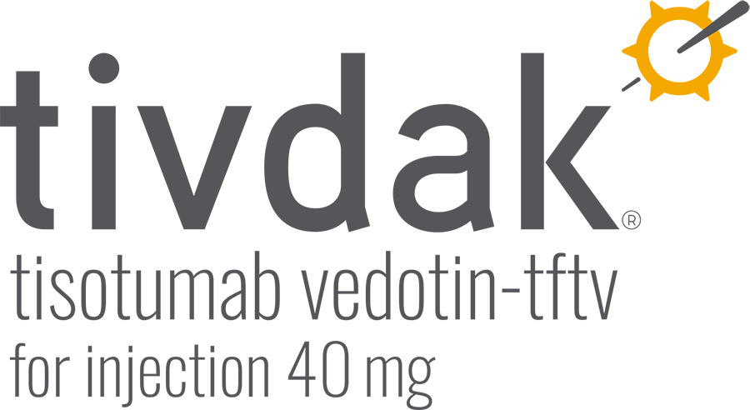

ZoomRx and Pfizer have a well-established partnership, collaborating on research since 2016
Key Highlights:
ABRYSVO – PET & NPP partner at launch (2023) for both older adult and maternal indications; Digital Tracking & HCP-Pt Conversations
PENBRAYA – HCP Patient conversations (2025)
PREVNAR – HCP Patient conversations (2025)
TUKYSA – PET partner since launch in late 2019 including support of the mCRC label expansion
IBRANCE – Digital Tracking partner to provide a comprehensive market-wide view of omnichannel promotional performance
ADCETRIS – PET Partner from late 2020 tracking cHL with proactive discussions to support Feb 2024 DLBCL launch
PADCEV – ATU, PET & NPP partner from late 2020, including support for 2023 launch into 1L as combination therapy with pembrolizumab
ZoomRx has partnered with additional Pfizer brands including XELJANZ, ORGOVYX, MYFEMBREE, TALZENA & BENEFIX
ZoomRx and Pfizer have an active MSA in place and ZoomRx is a Pfizer Preferred Vendor

Slide 5
Qual at Quant Scale: ZoomRx uses voice enabled technology and AI-driven dialogues to encourage deeper responses and more respondent engagement
Personalized Real Time Conversations
Collection of High Volume of Qual Data
Fluidic Quant / Qual Transitions
Richer Insights from Qual / Quant
Dynamic Questions
Field Asynchronously
Be Flexible
Delve Deeper
Customize the content & flow to the individual and the conversation based on discussion guide
Whenever and wherever convenient for the respondent
Seamless switching between audio/oral and text/visual mediums
Instant quant analysis PLUS rich supporting qual content & quotes
AI Follow-Ups – Additional Details
Parameters and guidelines of the AI generated responses are fully customizable by your team
Full transcripts / raw data of all conversations delivered at project end

Slide 6



Example: Collecting context specific real-time open ends via AI generated follow-up questions
ILLUSTRATIVE DATA
You indicated on a scale of 1-7 that your interaction with the Pfizer representative increased your likelihood to recommend Abrysvo. Please elaborate on your reasoning for this rating.
Thanks. Can you tell me more about specific data the representative shared that led to your high rating?
“The rep showed me that specific pregnancy related organizations have done the research and recommend this vaccine. Strong recommendations from National Organizations can reinforce compliance”
+ Optional additional level(s)of AI probing if needed. Probes and lines of questioning are designed in collaboration with your team.
Traditional surveys stop here, resulting in shallow or non-specific open- ended answers. Instead, ZoomRx AI Dialogues continues the conversation.
[HCP typing a more detailed response…]
“The rep shared good data with me”
AI Dialogues can also be captured through fully voiced questions and answers: view a demo on the ZoomRx Sagan AI Website

Slide 7


Real world example: Abrysvo Promotional Effectiveness Tracking
Dynamic Dialogues – Likelihood to Stock ABRYSVO
s = 70 | OBGYN Sample | W4: Aug ‘25 – Oct ‘25
Enhancing Stocking Likelihood - Verbatims
ZoomRx Study
ZoomRx Study
ZoomRx Study
STOCKER
OBGYN
STOCKER
OBGYN
NONSTOCKER
OBGYN
How can Pfizer reps further help enhance your likelihood to Stock ABRYSVO?
How can Pfizer reps further help enhance your likelihood to Stock ABRYSVO?
How can Pfizer reps further help enhance your likelihood to Stock ABRYSVO?
Help reassure me about cost, CDC recommendations, despite CDC contradicting recommendations on COVID which makes patient suspicious
The sales reps can reinforce clinical need by reiterating the disease burden. They can discuss the timeliness and stress the predictability of RSV "season" and the benefit of having the vaccine stocked and on hand for this. They can also highlight that during OB visits, this is a great captive window opportunity to discuss the vaccine and if a patient is agreeable, receive it at the time of the visit. If the vaccine is not on hand, the convenience for the patient is lost and they may not be as likely to get the vaccine at another visit or go to an outlying facility to receive it. Having it stocked and on hand eliminates this possible barrier to care.
I usually encourage sales representatives to leave in my office more educational materials for my patients regarding the medication/ vaccine that they are promoting. The more patients express interest in the medication the more likely that the practice will consider stocking it
Could you elaborate on how the Pfizer sales representative's approach to addressing cost and CDC recommendations could be further refined or expanded to better support your practice in stocking or discussing ABRYSVO?
Can you elaborate on how the Pfizer sales representative can effectively communicate these points about disease burden and the importance of timely stocking during their visits to your practice? What specific strategies or materials would be most helpful in reinforcing these messages?
What types of educational materials or information would be most helpful for your patients to better understand and express interest in ABRYSVO?
Our biggest hindrance to giving RSV vaccine is our patient skepticism of vaccines in general. This is worsened by current political climate. Patients are very suspicious right now, which is sad
The sales rep should focus on local impact and less on national stats or data points. They can use archetypes of patients that the provider typically sees as examples. Reframe RSV as predictable and preventable and the season can be worse in certain patient groups. Continue to emphasize missed opportunities for care if the vaccine is not stocked.
Written materials or educational posters will be sufficient for most patients
Source: US Abrysvo Maternal HCP CFC Promotional Effectiveness Tracking (ZoomRx)_Q3 ‘25
Question text in speaker notes | s = no. of interactions
Notes:
Questions Texts:
Q3.15 Please specify how Pfizer sales representatives can further help enhance your likelihood to [PIPE “STOCKING ABRYSVO” OR “DISCUSS STOCKING ABRYSVO with the relevant stakeholders”] in your practice during their interaction?

Slide 8


ZoomRx has the largest industry benchmark database to put findings in context, and understand “what good looks like”
ZoomRx Platform:
ZoomRx has over
700 M+ industry benchmarks
With 820+ biopharma brands tracked, ZoomRx has custom analogs that contextualize performance and reveal what success looks like in any market situation
Rep reach and frequency
Share of voice
Message recall and message impact
Sales rep performance
Rep closing
Visual aid use
NPP/digital reach and frequency
Quality and impact of digital content
Outreach channel mix
Customer outreach preferences
And more…
Promotional Benchmarks
Several analogs and benchmarks are available for ATUs such as
Awareness benchmarks
Aided, unaided
Attribute rating benchmarks
ANALOGS
SITUATION

Slide 9
ZoomRx has an engaged and stable in-house panel that enables robust and rapid insights and aligns to target audiences
ZoomRx Panel Size – Across Specialties
Panel Size (In Thousands) - ZoomRx
Specialty​ | ZoomRx Panel​
Primary Care​ | 9563​
Hematology/Oncology​ | 2926​
Pediatrics​ | 2444​
Emergency Medicine​ | 2351​
Psychiatry​ | 2182​
Surgery​ | 2158​
Neurology​ | 1862​
Gastroenterology​ | 1520​
Anesthesiology​ | 1294​
Obstetrics/Gynecology​ | 1223​
Pharmacist​ | 1151​
Cardiology​ | 1088​
Dermatology​ | 1044​
NP/PA​ | 15289​
>57K
Panelists
25+
Physician Specialties
27%
YoY Panel Growth

Slide 10


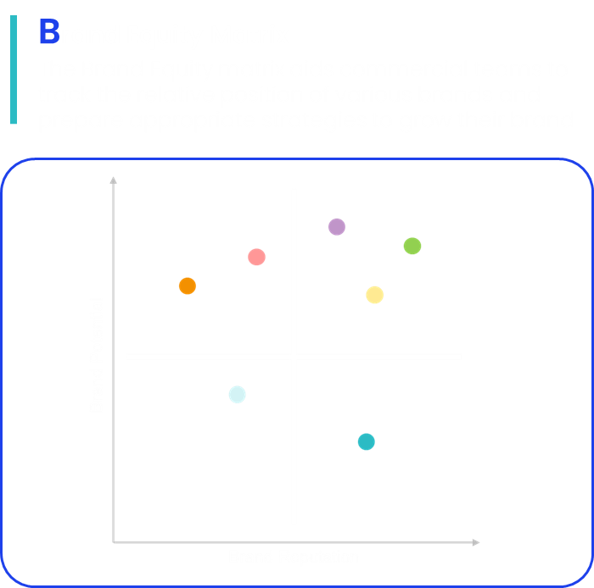
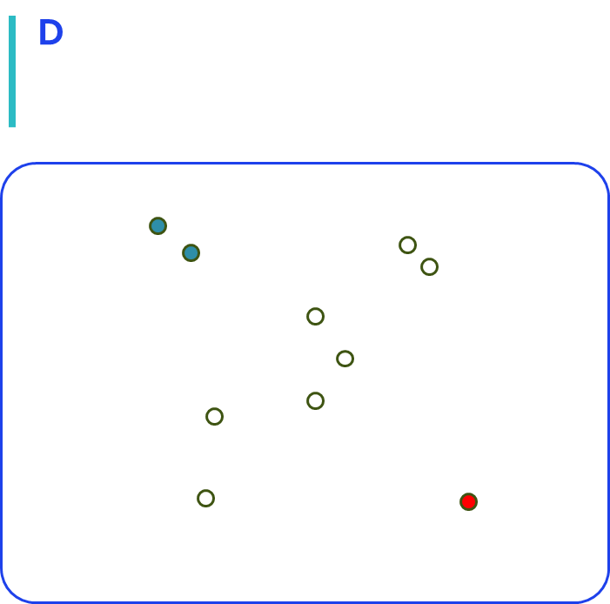
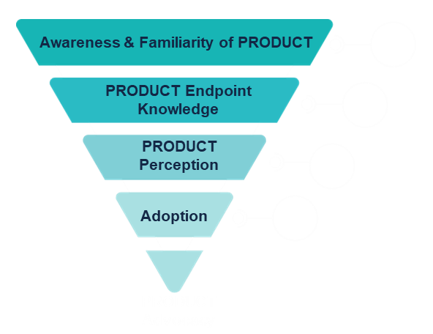
ZoomRx ATUs provide clear metrics & analytic frameworks for tracking
WHAT’S THE SITUATION?
SO WHAT?
NOW WHAT?
Metrics
Frameworks & Benchmarks to link metrics to performance
Actions
Aided, Unaided Awareness
Stated Importance
Drivers, Barriers
NPS
Current, Future Usage
And more
Attribute important / MaxDiff
Patient Adoption Funnel
Brand Equity Matrix
Derived vs. Stated importance
Perceptual Mapping
Fix “leaks” in adoption funnel
Enhance competitive positioning
Understand patient preferences
Act on implicit preferences
Personalize patient communication
Optimize promotional tactics
Brand Equity Matrix
Patient Adoption Funnel
Derived Importance
The Brand Equity Matrix helps commercial teams to track the relative position of various brands and prepare appropriate strategies to grow their brand
Understand the Treatment Journey (awareness, sources of info, perception, request, prescription) and fix “leaks” in the Adoption Funnel
There is always more than meets the eye. We use derived vs stated importance to understand how intrinsic factors impact patient treatment choice

Slide 11




Switching to ZoomRx: We have extensive experience working with clients who switch to ZoomRx tracking from other vendors
ZoomRx: Our Approach to Switching
Maintain Consistency in Deliverables
Preserve Reporting Patterns
Refine Survey for Actionable Insights
Interim Checkpoint for Alignment
Review existing deliverables by current vendor (reports, leadership slides, dashboards, data feeds, etc) and ensure all these deliverables are replicated to maintain continuity from a KPI and reporting standpoint
Understand the current reporting cadence (monthly, quarterly, rolling, or exclusive) and replicate it to avoid any disruption in trend analysis.
ZoomRx will collaborate to review KBQs and refine (or completely re-vamp if desired) the survey to provide more actionable insights and recommendations depending upon the brand needs.
Share an interim report to align on findings. If there are significant differences from past waves, adjust the survey accordingly

Slide 12
ZoomRx and Pfizer PENBRAYA ATU Pilot
1. INTRO TO ZOOMRX & ATU PLATFORM
2. PFIZER/ZOOMRX PENBRAYA ATU PILOT

Slide 13
ZoomRx Penbraya ATU Pilot Scope
Survey | Details
Sample and Segments | N = 100 total HCPs (N = 80 PEDs; N = 20 PCPs) Loyalty segments: ~50% Tier 1, 25% Tier 2, 25% Tier 3
Length of Survey | ~25 minutes
Fielding Duration | ~4 weeks
Target Sample | Pfizer Target List MDs
Key Screening Criteria | Stock / administer MenACWY vaccines Stock / administer MenB vaccines At least 60% of patients 16 to 18 years of age must receive at least one dose of MenACWY vaccine and at least 20% must receive at least one dose of MenACWY + MenB vaccine All must at least be open to vaccinating all their adolescent patients against all key meningococcal serogroups (ACWY and B)
Deliverables | Final Deep Dive Report
Note on future waves
The scope shown is for the zero-cost pilot wave
Any continuation waves will have an increased sample size and survey length

Slide 14
Survey Outline
1
2
3
Disease State Awareness & Urgency to Discuss Vaccines
Current Vaccine Preferences
Penbraya Branded Evaluation
Familiarity meningococcal vaccines
Current stocking
Current recommendation/ administration
Impression of Penbraya
Likelihood to recommend/stock Penbraya
Future adoption
Level of vaccine knowledge
Perceived risk
Urgency to vaccinate
4
5
6
Barriers to Prescribing
Competitive Evaluation
Vaccine Manufacturers & Sales Engagement
Challenges experienced or anticipated
- Storage/logistics
- Scheduling
- Contracting/Costs
- Insurance
Positioning vs competitors (Penmenvy)
Comparative perceptions
Future adoption
Rep engagement

Slide 15
Timeline: The suggested timeline for the pilot ATU is shown below:
Survey finalization, compliance review, programming
w/o Feb 9
Full Report
w/o Mar 23
Survey drafting, survey iteration, feedback
w/o Feb 2
Fielding
~Feb 16 – Mar 16
Debrief on results & Iterate on survey
w/o Mar 23
ZoomRx is flexible to adjust or accelerate project timelines to meet the team’s needs

Slide 16

Keep in touch
nicholas.fleischman@zoomrx.com

Slide 17





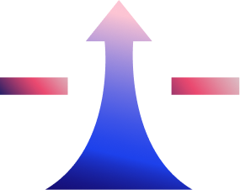






ZoomRx has deep expertise throughout the product lifecycle
EARLY ASSET PLANNING
LAUNCH PLANNING
COMMERCIALIZATION
Patient
Journey
Buying
Process
Drivers & Barriers
DSE Campaign Testing
Concept & Message Testing
Performance Tracking
TPP Testing / Feasibility
Market Demand / Forecasting
Market Segmentation
Positioning
IVA / Detailing
Promotional Effectiveness
FEASIBILITY ASSESSMENT
MARKET UNDERSTANDING
CUSTOMER TARGETING
BRAND COMMUNICATION & DEVELOPMENT
LAUNCH PERFORMANCE PLANNING
ZoomRx uses data-driven evidence to assess the market entry feasibility
ZoomRx expertise garner powerful insights to help your team deeply understand your competitive target market and build a better roadmap for launch
ZoomRx leverages an integrated approach of primary and secondary research to identify your key customer groups
Using the proprietary PHYCURE strategic framework and testing process, ZoomRx helps your team identify optimal positioning and communication for your brand
Leverage the industry leading ZoomRx approach to capture the true impact of launch interactions and communications

Slide 18
The following are additional example slides from the latest Pfizer and ZoomRx ABRYSVO Maternal CFC / Message Tracker, which utilized ZoomRx AI Dialogues

Slide 19
Appendix – Overall Findings
Final Report (Aug – Oct ‘25)
Reasoning for ABRYSVO’s High Call Quality - Verbatims
Dynamic Dialogues – Overall Call Quality – Highly Rated Interactions
s = 87 | W4: Aug ‘25 - Oct ’25 | Interaction Rated 6,7 on Overall Call Quality
ZoomRx Study
ZoomRx Study
ZoomRx Study
*ZoomRx Study
STOCKER
OBGYN
STOCKER
OBGYN
STOCKER
OBGYN
NONSTOCKER
PED
Please specify briefly on what went well in the interaction.
Please specify briefly on what went well in the interaction.
Please specify briefly on what went well in the interaction.
Please specify briefly on what went well in the interaction.
They didn’t waste my time with useless information. They were quick and to the point and understood we have a very busy clinic, and our priority is our patient's time
I appreciated the succinctness of the presentation. I appreciated their ability to immediately answer my questions. I appreciated the efficient use of my time
The representative from Pfizer was very well informed and able to discuss the vaccines in a professional and knowledgeable manner
Very respectful of time and our office schedules and presented to our staff well, supplemented by iPad imaging
Can you elaborate on how the use of iPad imaging during the presentation enhanced your understanding or engagement with the information provided?
Could you elaborate on which aspects of the rep's knowledge or professionalism stood out during the discussion about vaccines?
Can you share more about how the Pfizer sales representative managed to be succinct and efficient during the presentation? What specific aspects of their approach stood out to you?
Could you elaborate on how the Pfizer sales representative effectively communicated the essential information? What specific approach or aspect of their interaction made it feel efficient and respectful of your time?
Was supportive of statements and illustrated bar graphs for percentages, etc. Helped to amplify statistics
She was well prepared to answer any questions and to discuss the vaccine fully. This was in spite of the fact that she knew that we would not be ordering this specific vaccine as we do not immunize pregnant women in this pediatric office.
The sequence of slides that reflects a bare basics approach in order to best utilize my time
Providing pamphlets and brochures and not lecturing me
Could you share more about how the use of bar graphs and visual aids impacted your perception or understanding of the data presented?
Could you describe how the pamphlets and brochures provided by the Pfizer sales representative were particularly helpful or informative for you? What made these materials stand out in supporting your needs?
Could you elaborate on how the "bare basics" approach in the slide sequence contributed to the effectiveness of the presentation? What elements of this approach did you find most beneficial?
Can you share more about how her preparedness and willingness to engage in the discussion, despite knowing the vaccine wouldn't be ordered, impacted your perception of the interaction?
Reinforced numbers, made these percentages clearer
They hit the high points of effectiveness, when to give, what it's trying to prevent, cost and coverage.
Easy to read diagrams, easy to share with patients
And as a result, I am more likely to recommend that the mothers discuss this with the OB/GYN
Source: US Abrysvo Maternal HCP CFC Promotional Effectiveness Tracking (ZoomRx)_Q3 ‘25
Question text in speaker notes | s = no. of interactions | *Question text shortened. Full Question text in the Speaker notes
Notes:
Questions Texts:
Q3.65B Doctor, you have rated overall quality of Pfizer sales representative interaction to be high. Please specify briefly on what went well in the interaction.
*Full Question text
1)Doctor, you have rated overall quality of Pfizer sales representative interaction to be high. Please specify briefly on what went well in the interaction.
2)Could you elaborate on which aspects of the representative's knowledge or professionalism stood out to you during the discussion about the vaccines?
3)That's great to hear. Can you share more about how her preparedness and willingness to engage in the discussion, despite knowing the vaccine wouldn't be ordered, impacted your perception of the interaction?

Slide 20
Appendix – Overall Findings
Final Report (Aug – Oct ‘25)
Improving ABRYSVO’s Call Quality - Verbatims
Dynamic Dialogues – Overall Call Quality – Need for improvements
s = 15* | W4: Aug ‘25 - Oct ’25 | Interaction Rated <=5 on Overall Call Quality
ZoomRx Study
ZoomRx Study
ZoomRx Study
ZoomRx Study
STOCKER
OBGYN
STOCKER
OBGYN
STOCKER
PED
STOCKER
PED
How could your most recent interaction have been improved?
How could your most recent interaction have been improved?
How could your most recent interaction have been improved?
How could your most recent interaction have been improved?
On follow up visits, I would like to have materials that my staff can review and some for patients in waiting rooms to review. There are still many health professionals and members of the general population unfamiliar with RSV and vaccines available
They provided a pretty standard detail and would not really go into specifics when pushed for other data
It was not a bad sales call and it was helpful, however she did not provide information about how it would be covered for moms, out of pocket cost of vaccination, safety, and comparisons to other RSV vaccinations on the market
Would be better if we spent more time actually getting to know each other so you understand the basics of my individual practice rather than the generic tag lines that they’re supposed to deliver
Could you share some examples of the specific types of information or data you would have liked the Pfizer sales representative to provide during the call?
Could you elaborate on the type of information or resources you would find most helpful regarding coverage, cost, safety, and comparisons to other RSV vaccinations?
Could you elaborate on the types of materials or resources you believe would be most effective for both your staff and patients in enhancing their understanding of RSV and the available vaccines?
Could you share more about the specific aspects of your practice that you feel would be valuable for the sales representative to understand better?
When we ask about any current clinical data that has not been released, they are not willing to go outside their talking points
It would be helpful to have a comparison between different RSV vaccinations. I would like to have a better understanding of insurance coverage and cost for comparison as well as differences in efficacy and safety would also be appreciated
Patient-friendly language. English and Spanish
Knowing me individually is important
What kind of clinical data or insights would be most valuable for you during these interactions, and how could the sales representative better address your needs in this area?
Thank you for specifying that. Could you describe any particular formats or types of materials that you think would be most engaging or useful for your patients and staff, such as brochures, posters, or digital content?
What are some specific ways the sales representative could get to know you and your practice better during their visits?
Could you please describe how you would prefer this comparative information on RSV vaccinations to be presented during the sales call for it to be most useful to you and your multi-specialty group?
Comparison data of RSV incidence in newborns during 1st RSV season whose mothers received this vaccine vs. those vaccinated with Beyfortus.
Spending time getting to know the practice
Brochures. Posters or cards with QR codes
I elaborated in the previous question
Source: US Abrysvo Maternal HCP CFC Promotional Effectiveness Tracking (ZoomRx)_Q3 ‘25
* Low Sample size | Question text in speaker notes | s = no. of interactions
Notes:
Questions Texts:
Q3.65A Doctor, you have rated overall quality of Pfizer sales representative interaction to be moderate – low. How could the overall sales call quality with the Pfizer sales representative be improved?

